Slide 1
Applied Data Science with R Capstone project
Tianyuan Zhu
8/4/2022

Slide 2

Outline
Executive Summary
Introduction
Methodology
Results
Conclusion
Appendix

Slide 3

Executive Summary
This report focuses on the analysis about the how the weather impacts the bike-sharing demand in Seoul.
Data Collection
Weather Data: OpenWeather APIs
Bike-sharing Data: Web scrape a Wiki Page
Data Wrangling
Deal with undesired reference links, missing value, indicator variables, normalization.
Exploratory Data Analysis
SQL
Data visualization with different types of plots
Develop and find regression model with best performance
Create interactive dashboard for data analysis visualization

Slide 4

Introduction
A bicycle-sharing system, bike share program, public bicycle scheme, or public bike share (PBS) scheme, is a shared transport service in which bicycles are made available for shared use to individuals on a short-term basis for a price or free.
Objective: Investigate how weather would affect bike-sharing demand in urban areas, specifically, Seoul.

Slide 5

Methodology
Perform data collection
Perform data wrangling
Perform exploratory data analysis (EDA) using SQL and visualization
Perform predictive analysis using regression models
How to build the baseline model
How to improve the baseline model
Build a R Shiny dashboard app

Slide 6
Methodology

Slide 7
Data collection
The data collection process is shown in the following flowchart (see Appendix for screenshots of codes and output):
Web scrape a Global Bike-Sharing Systems Wiki Page: Extract bike sharing system data and convert the data to a data frame
OpenWeather APIs Calls: Get the current weather data for a city and 5-day weather forecast for a list of cities

Slide 8
Data wrangling
The data wrangling process is shown in the following flowchart (see Appendix for screenshots of codes and output):
Standardize column names for all collected datasets
Remove undesired reference links using regular expressions
Extract numeric values using regular expressions
Detect and handle missing values
Create indicator (dummy) variables for categorical variables
Normalize data

Slide 9
EDA with SQL
Summary of performed SQL queries (see Appendix for screenshots of codes and output):
Determine how many records are in the seoul_bike_sharing dataset.
Determine how many hours had non-zero rented bike count.
Query the the weather forecast for Seoul over the next 3 hours.
Find which seasons are included in the seoul bike sharing dataset.
Find the first and last dates in the Seoul Bike Sharing dataset.
Determine which date and hour had the most bike rentals.
Determine the average hourly temperature and the average number of bike rentals per hour over each season. List the top ten results by average bike count.
Find the average hourly bike count during each season.
Consider the weather over each season. On average, what were the TEMPERATURE, HUMIDITY, WIND_SPEED, VISIBILITY, DEW_POINT_TEMPERATURE, SOLAR_RADIATION, RAINFALL, and SNOWFALL per season?
Use an implicit join across the WORLD_CITIES and the BIKE_SHARING_SYSTEMS tables to determine the total number of bikes available in Seoul, plus the following city information about Seoul: CITY, COUNTRY, LAT, LON, POPULATION, in a single view.
Find all cities with total bike counts between 15000 and 20000. Return the city and country names, plus the coordinates (LAT, LNG), population, and number of bicycles for each city.

Slide 10
EDA with data visualization
Summary of charts (see Appendix for screenshots of codes and output):
A scatter plot of RENTED_BIKE_COUNT vs DATE
The same plot of the RENTED_BIKE_COUNT time series, but add HOURS as the colour
A histogram overlaid with a kernel density curve
A scatter plot to visualize the correlation between RENTED_BIKE_COUNT and TEMPERATURE by SEASONS
A display of four boxplots of RENTED_BIKE_COUNT vs. HOUR grouped by SEASONS
Group the data by DATE, and use the summarize() function to calculate the daily total rainfall and snowfall

Slide 11
Predictive analysis
The process of building, evaluating, improving and finding the best performing model is shown in the following flowchart:
Split data into training and testing datasets
Build a linear regression model using only the weather variables
Build a linear regression model using both weather and date variables
Evaluate the models and identify important variables
Add polynomial terms
Add interactions terms
Add regularizations terms
Experiment to search for improved models

Slide 12
Build a R Shiny dashboard
Summary of plots and interactions in the dashboard:
A basic max bike prediction overview map
A select input (dropdown menu) to select a specific city
Users can select a specific city to show its detailed weather label
Detailed plots for a city:
A static temperature trend line
An interactive bike-sharing demand prediction trend line
A static humidity and bike-sharing demand prediction correlation plot

Slide 13
Results
Exploratory data analysis results
Predictive analysis results
A dashboard demo in screenshots

Slide 14
EDA with SQL

Slide 15
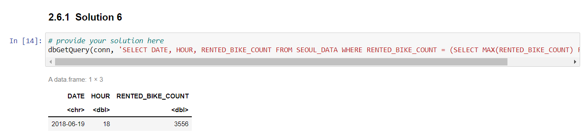
Busiest bike rental times
The busiest bike rental time is on 2018-06-19 around 18:00.

Slide 16
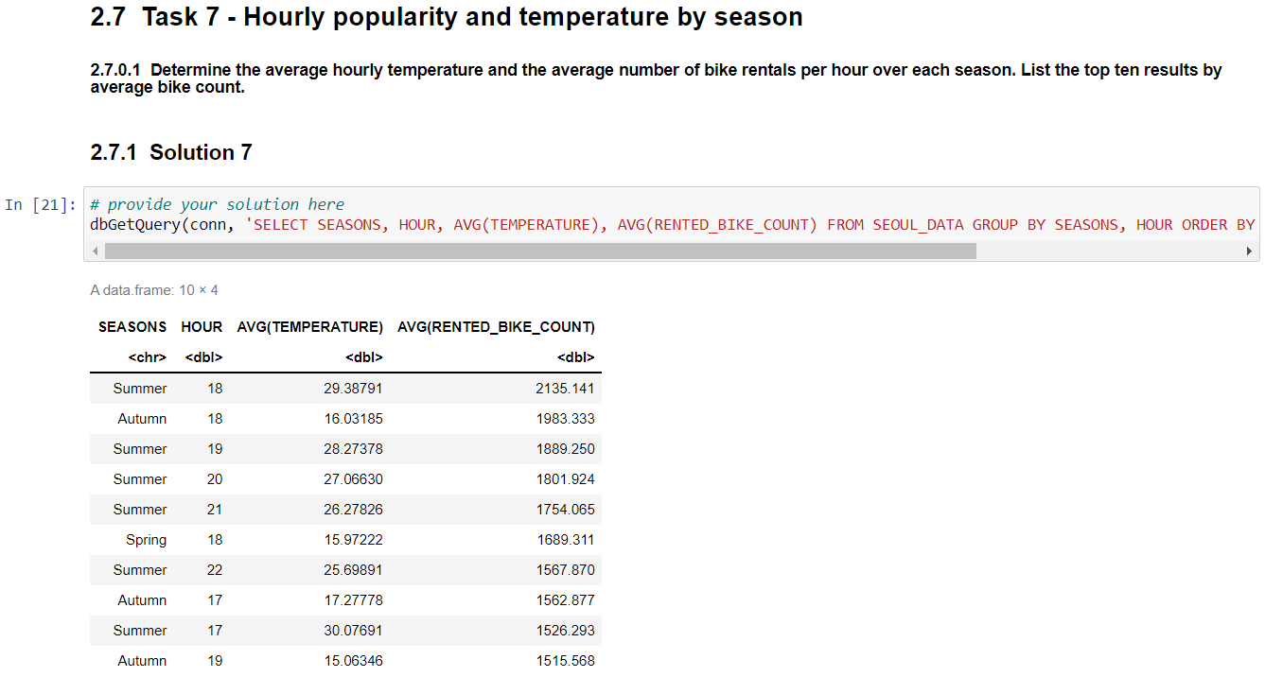
Hourly popularity and temperature by seasons
The top 10 most popular seasons and hours are shown as follows:

Slide 17
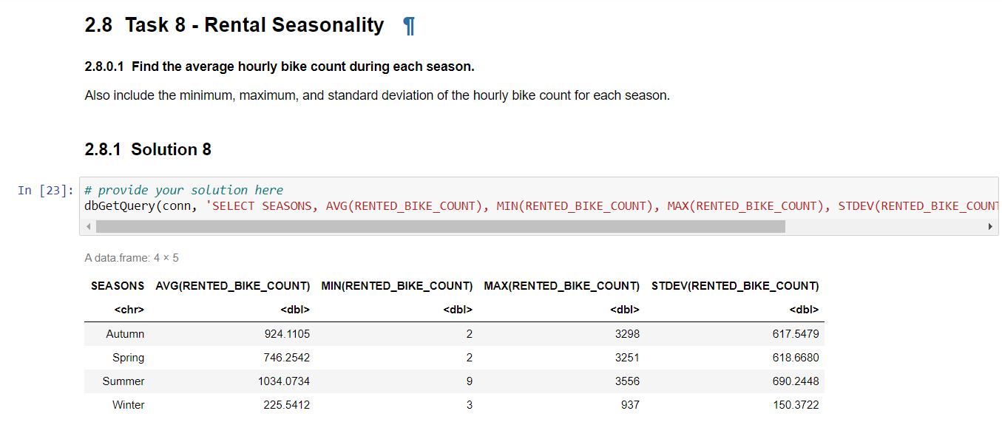
Rental Seasonality
The average, minimum, maximum and standard deviation of hourly bike count for each season are shown as follows:

Slide 18
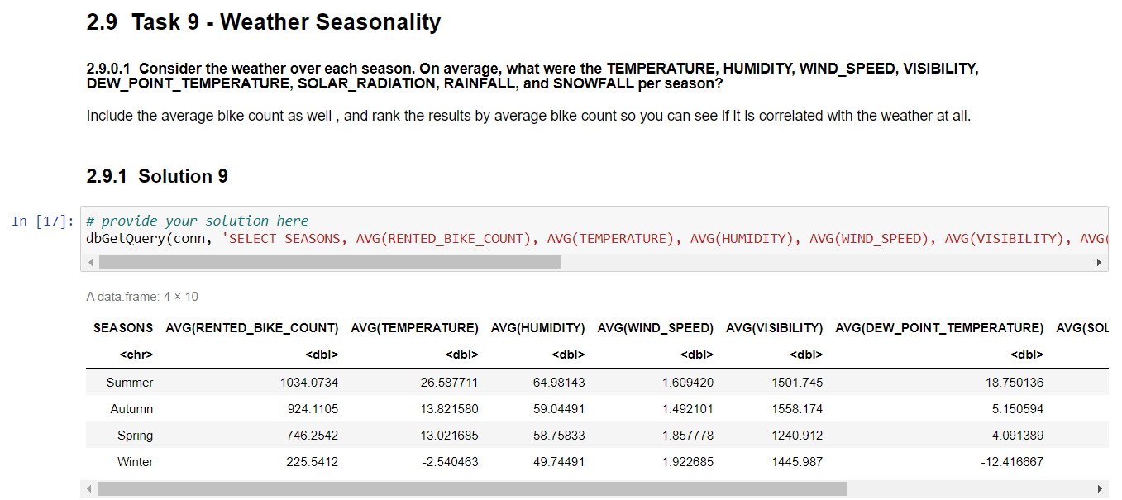
Weather Seasonality
The average temperature, humidity, wind speed, visibility, dew point temperature, solar radiation, rainfall and snowfall for each season are shown as follows:

Slide 19
Bike-sharing info in Seoul
Find the total Bike count and city info for Seoul
Present your query result with a short explanation here

Slide 20
Cities similar to Seoul
Find all city names and coordinates with comparable bike scale to Seoul's bike sharing system
Present your query result with a short explanation here

Slide 21
EDA with Visualization

Slide 22
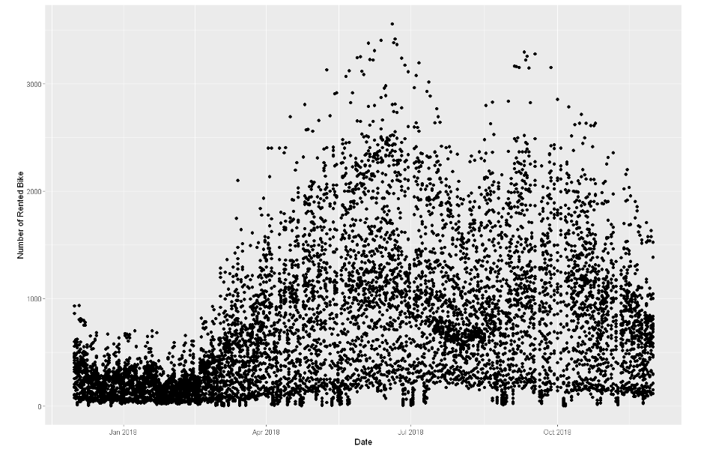
Bike rental vs. Date
In 2018, the bike rental increases in spring and fall and decreases in summer and winter.

Slide 23
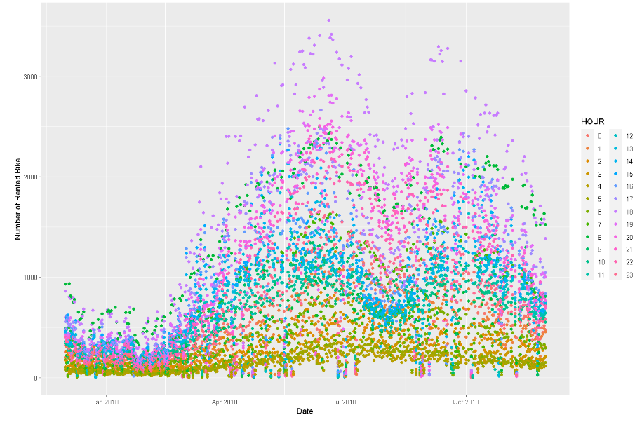
Bike rental vs. Datetime
In 2018, the busiest time for bike rental is in spring and fall during 18:00-19:00.

Slide 24
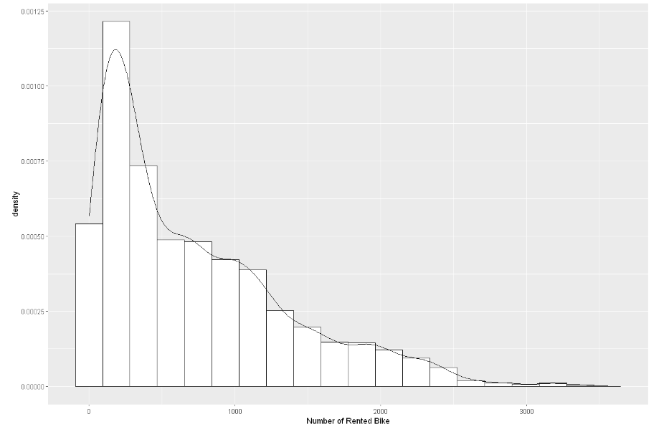
Bike rental histogram
We can see from the histogram that most of the time there are relatively few bikes rented. Indeed, the 'mode', or most frequent amount of bikes rented, is about 250.
Judging by the 'bumps' at about 700, 900, and 1900, and 3200 bikes, it looks like there may be other modes hiding within subgroups of the data.
Interestingly, judging from the tail of the distribution, on rare occasions there are many more bikes rented out than usual.

Slide 25
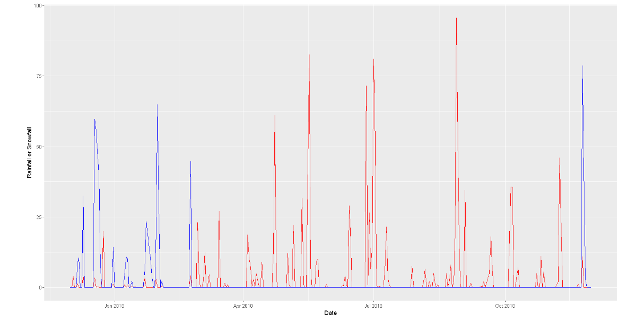
Daily total rainfall and snowfall
The highest total daily rainfall exists in summer while the highest total daily snowfall exists in winter.

Slide 26
Predictive analysis

Slide 27
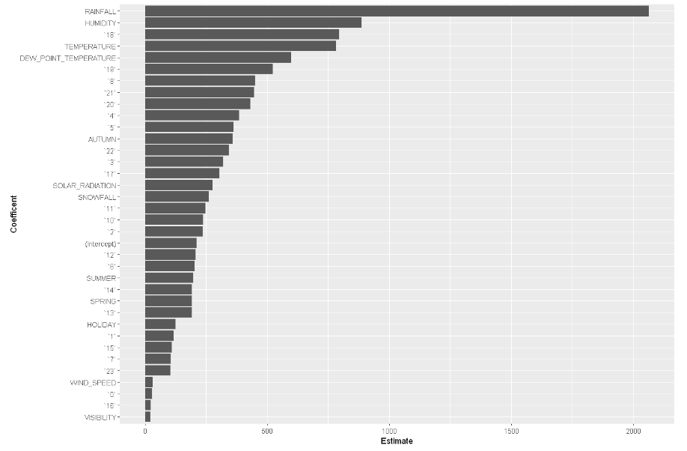
Ranked coefficients
The most relevant variables for bike rental prediction are rainfall, humidity, hour of 18:00, temperature and dew point temperature. Rainfall and humidity are relevant as people are less likely to ride bikes when it rains. 18:00 may be the busiest hour since its peak hour when people get back from work. Hence, riding a bike can be a better choice due to the heavy traffic on the road.

Slide 28
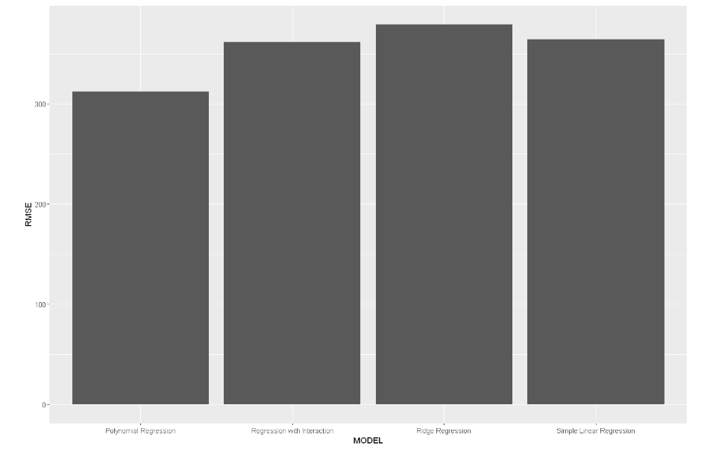
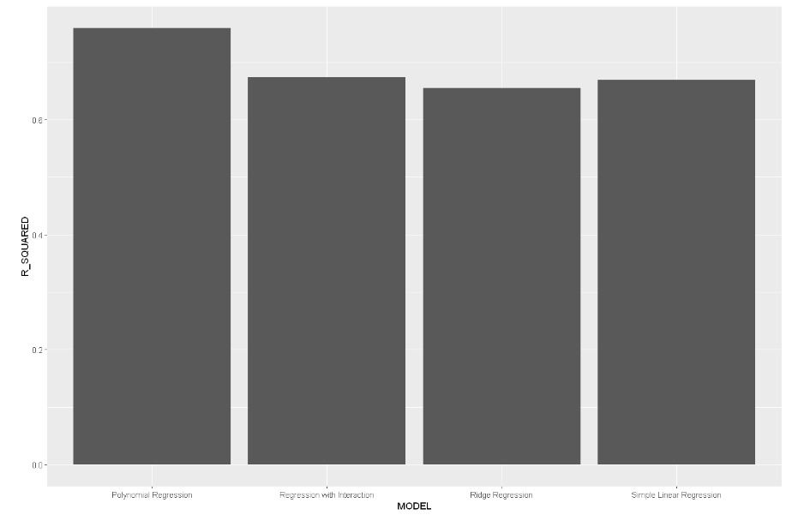
Model evaluation
The polynomial regression model has the best performance.

Slide 29
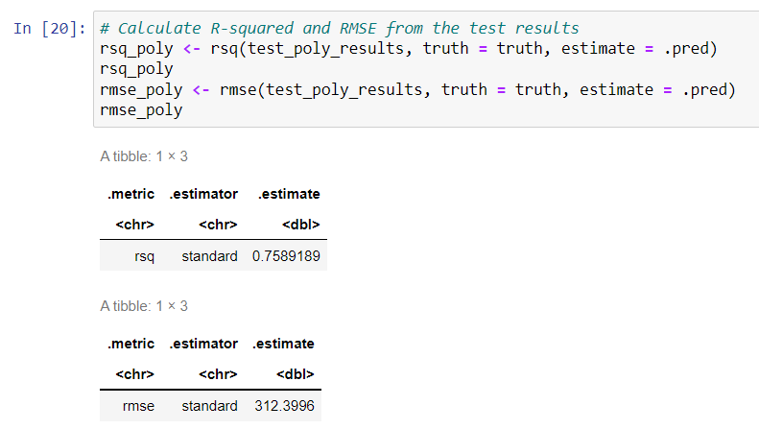
Find the best performing model
Formula: RENTED_BIKE_COUNT ~ poly(RAINFALL, 8, raw=TRUE) + poly(HUMIDITY, 4, raw=TRUE) + `18` + poly(TEMPERATURE, 4, raw=TRUE) + poly(DEW_POINT_TEMPERATURE, 3, raw=TRUE) + `19`+ `8` + `21` + `20`+ `4` + `5`+ AUTUMN + `22` + `3` + `17` + SOLAR_RADIATION + SNOWFALL + `11`+ `10` + `2` + `12` + `8` + SUMMER +`14` + SPRING + `13` + HOLIDAY + `1`+ `15` + `7` + `23` + WIND_SPEED +`0` + `16` + VISIBILITY
Performance:

Slide 30
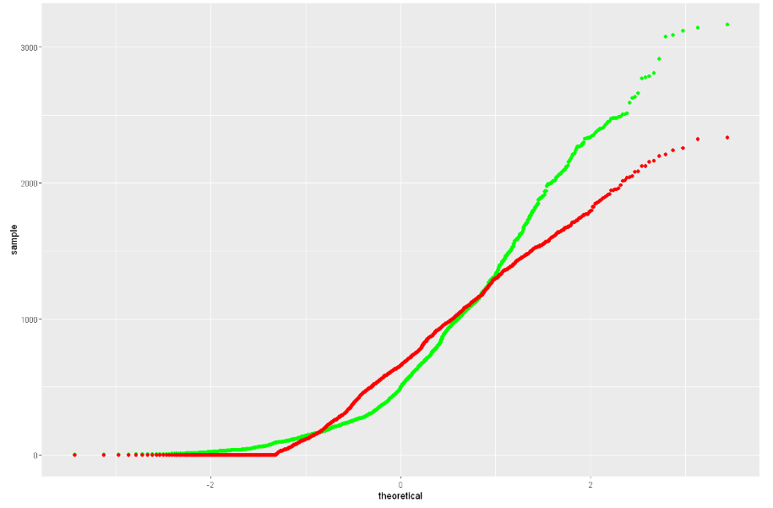
Q-Q plot of the best model

Slide 31
Dashboard

Slide 32
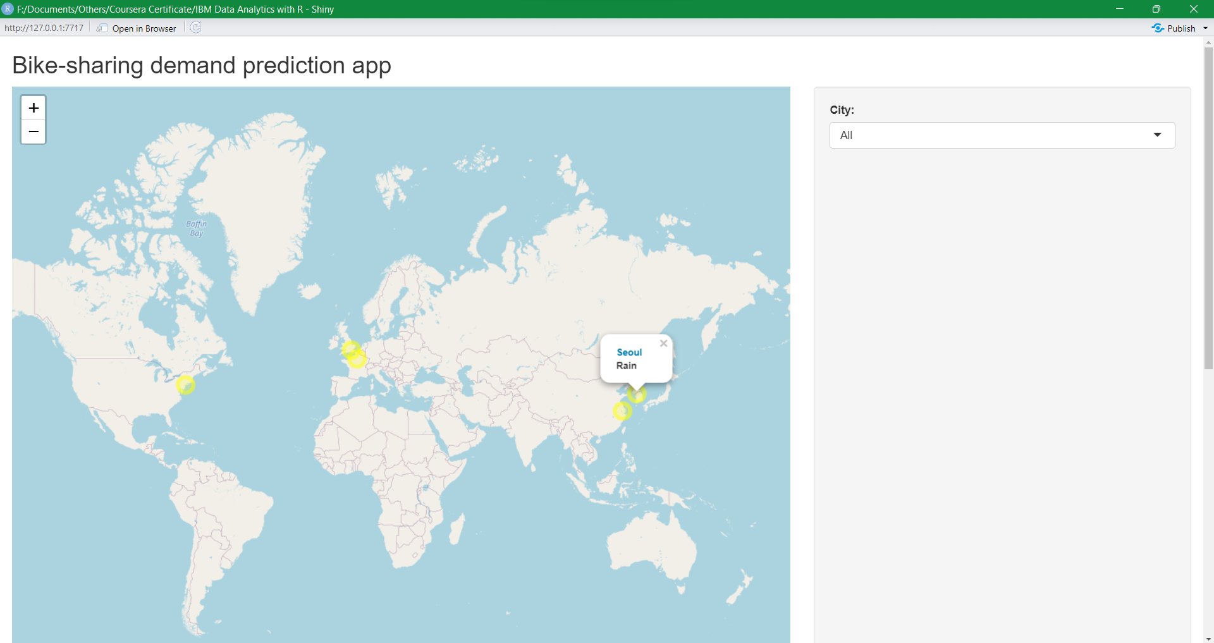
Overview of Bike-sharing prediction
Each circle marker represents a city, size and color of the circle shows the maximum bike demand prediction level for the city (small: size 6 and green color, medium: size 10 and yellow color, large: size 12 and red color). Click the circle shows the city name and the weather.

Slide 33
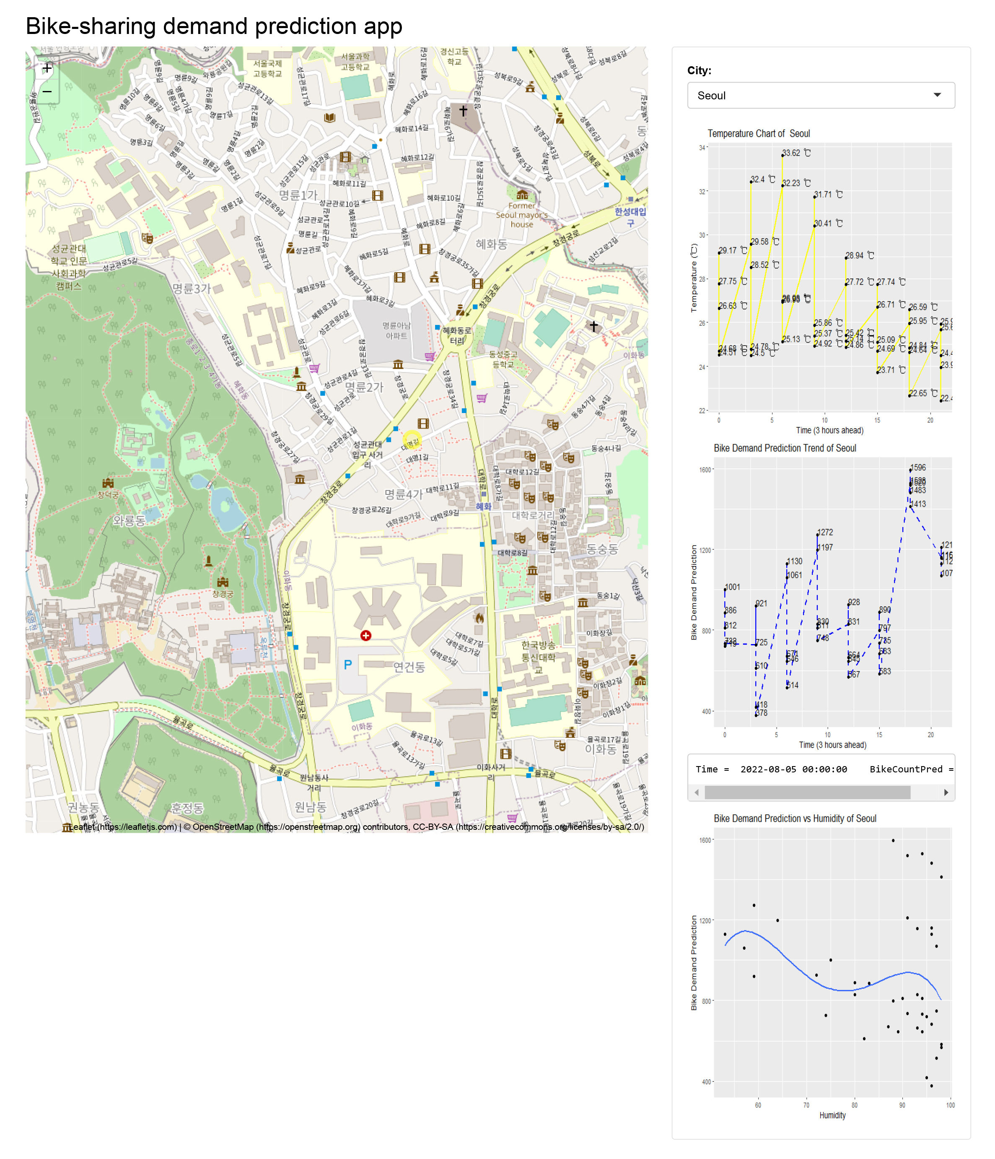
Detailed information of Seoul
The plots on the right shows the temperature trend, biked demand prediction trend and bike demand prediction vs. humidity for Seoul.

Slide 34
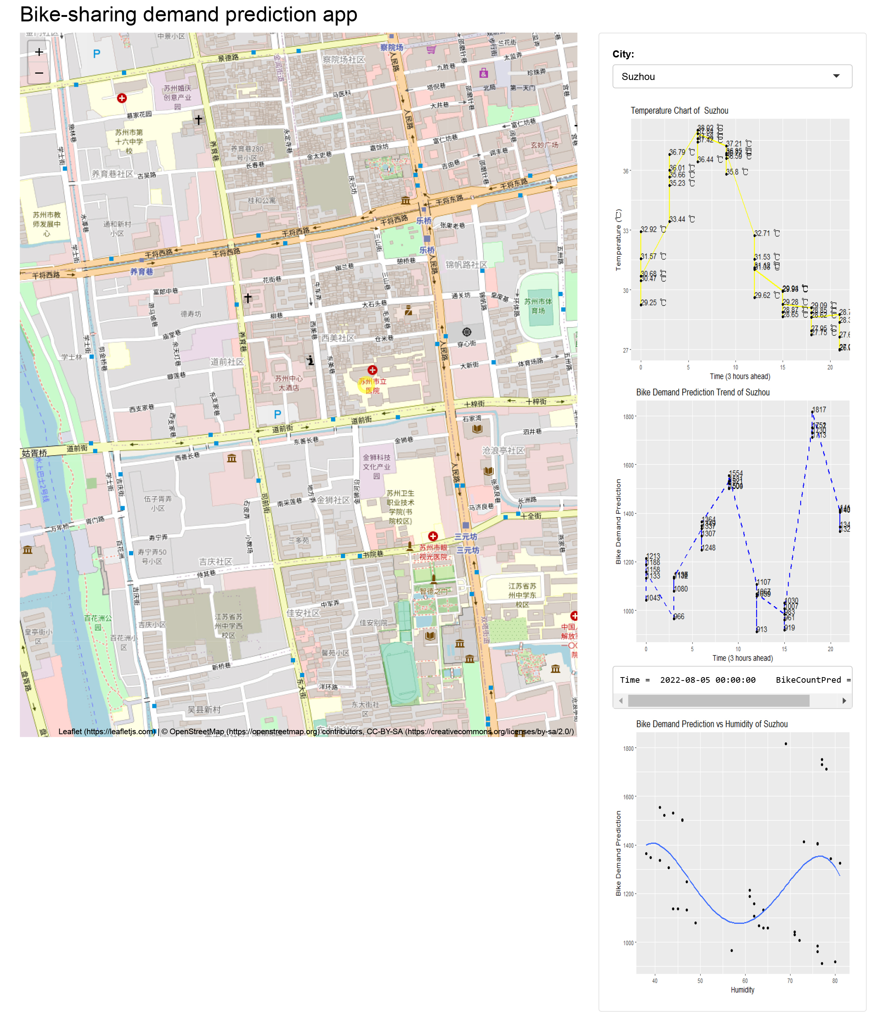
Detailed Information of Suzhou
The plots on the right shows the temperature trend, biked demand prediction trend and bike demand prediction vs. humidity for Suzhou.

Slide 35

CONCLUSION
Demand for bike-sharing is high during spring and fall and low in summer and winter.
The busiest time for bike-sharing is around 18:00.
The most relevant variables for bike-sharing demand prediction are rainfall, humidity, temperature, dew point temperature.
The relationships between the variables mentioned above and the bike-sharing demand are polynomial.

Slide 36

APPENDIX
Data Collection: OpenWeatherAPI
Data Collection: Webscrping
Data Wrangling
SQL Queries
EDA Plots

Slide 37
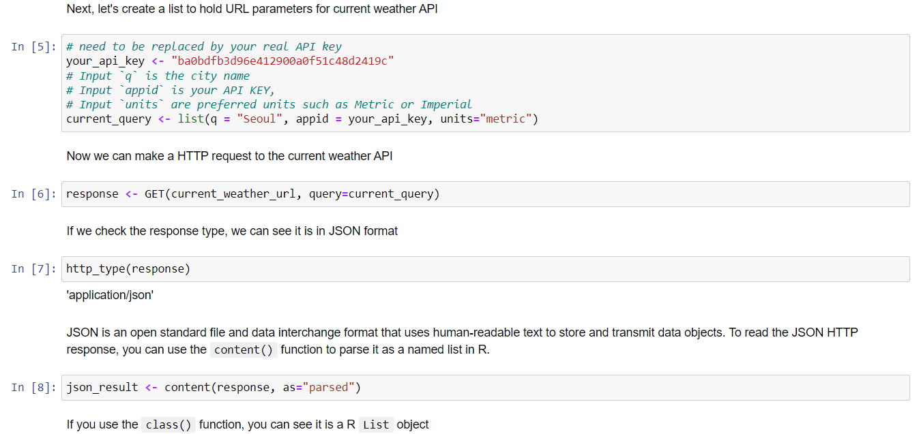
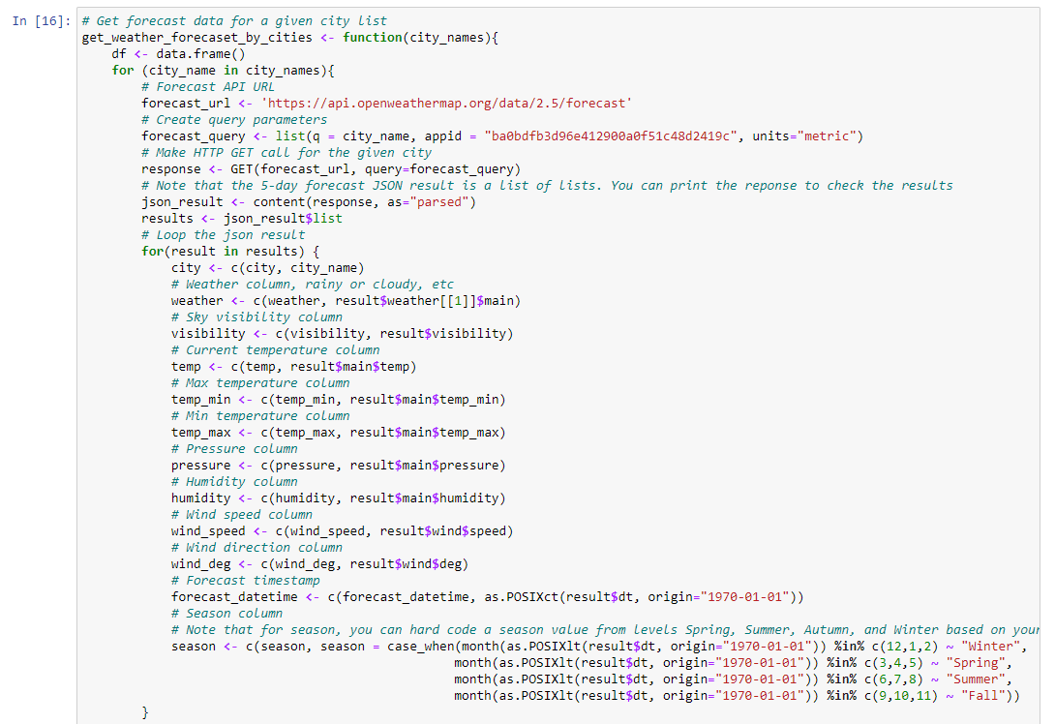
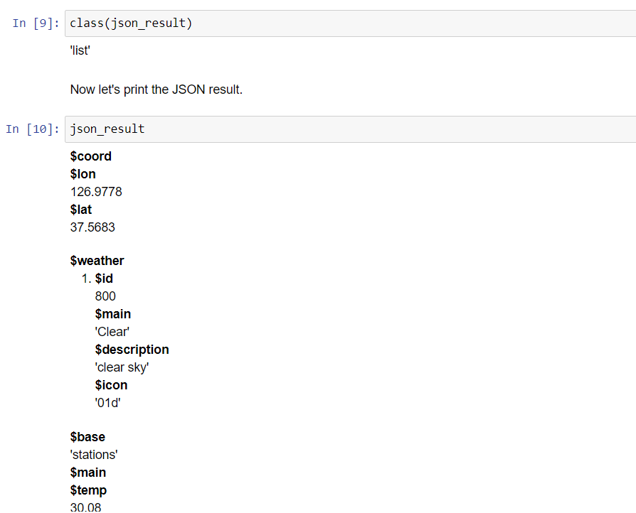
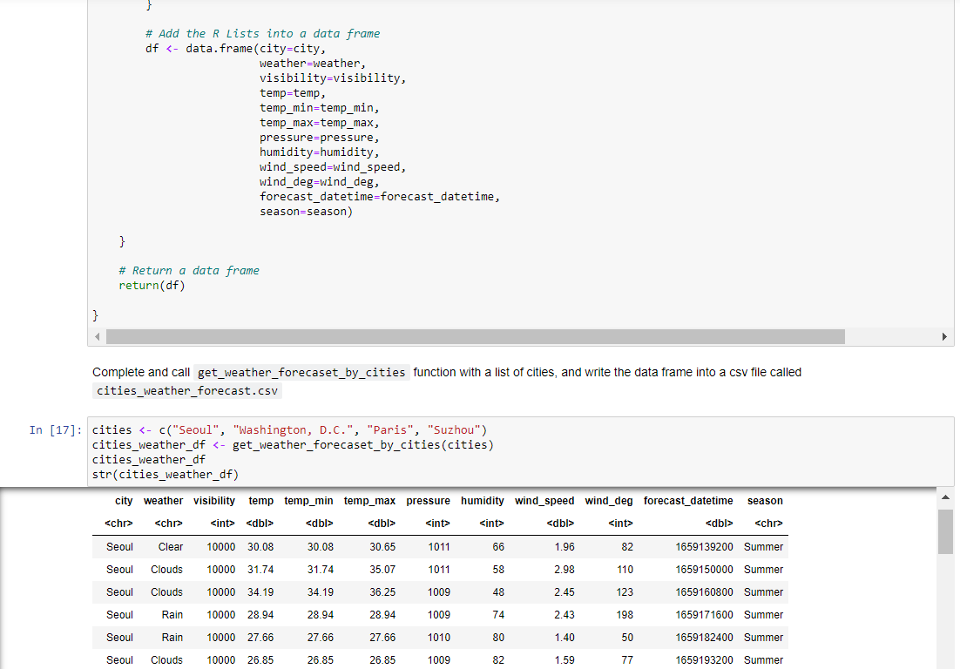
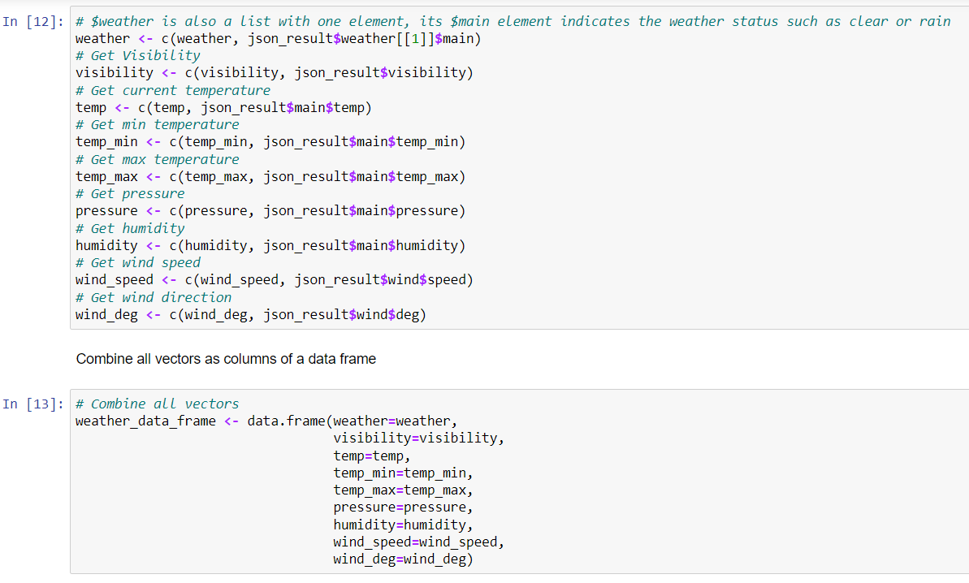
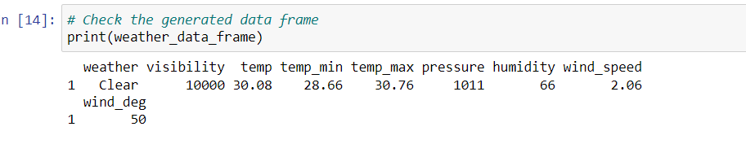
Data Collection: OpenWeatherAPI

Slide 38
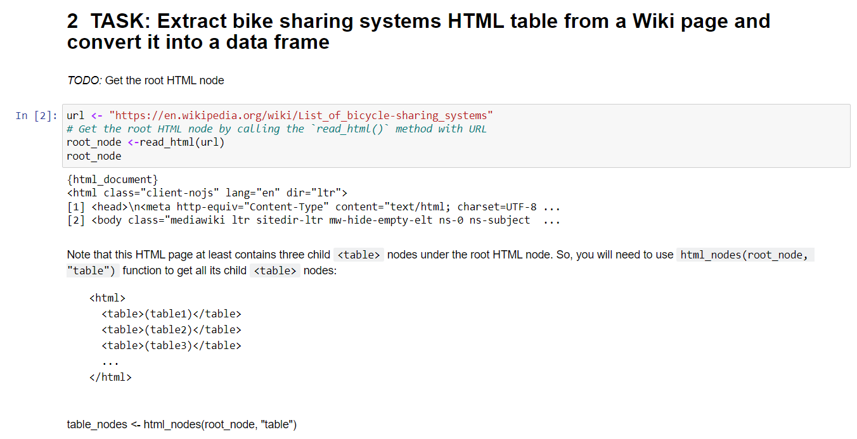
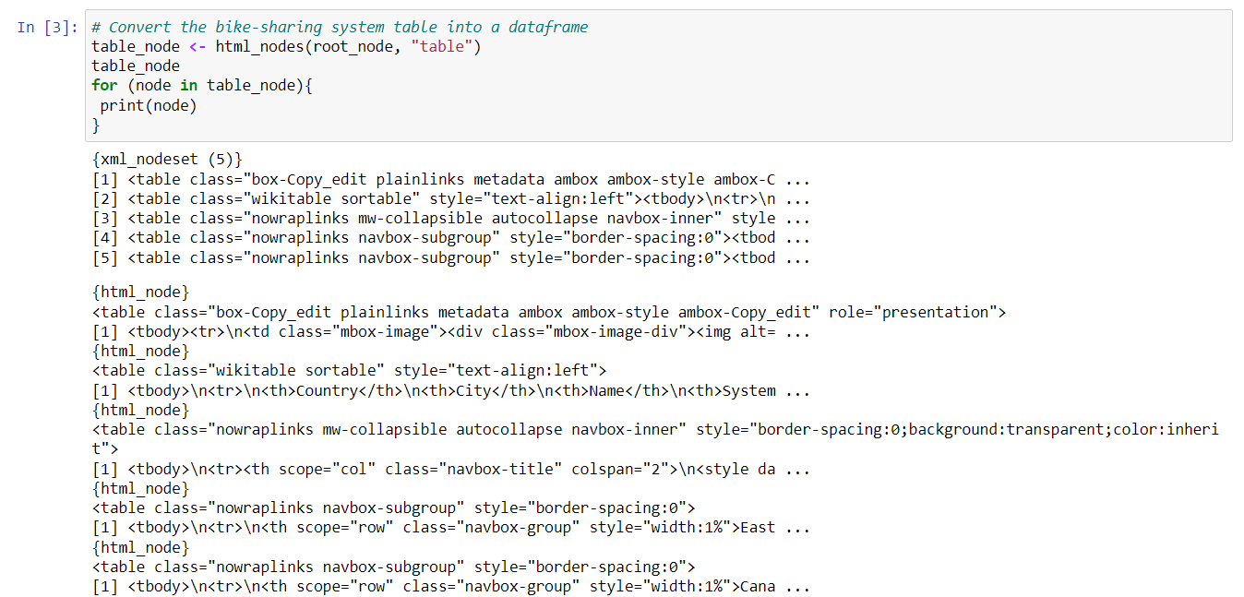
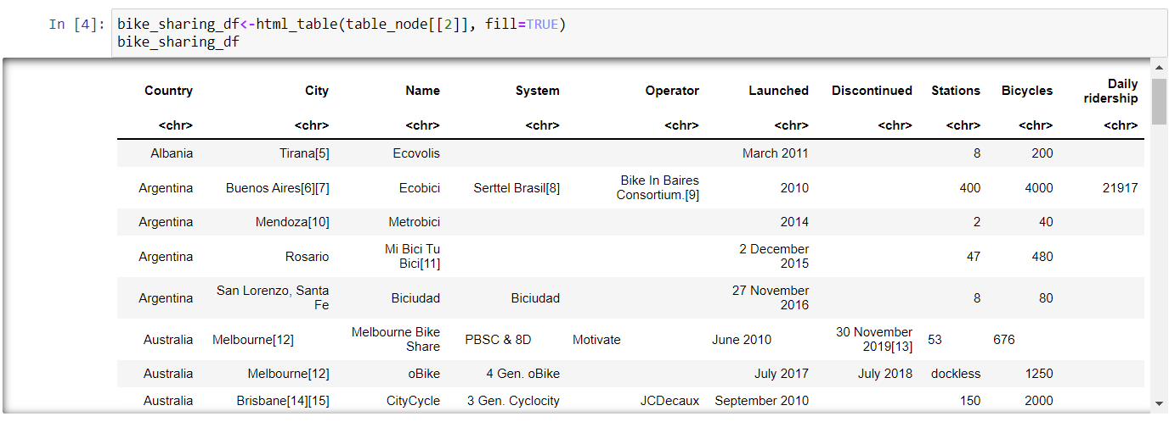
Data Collection: Webscrping

Slide 39
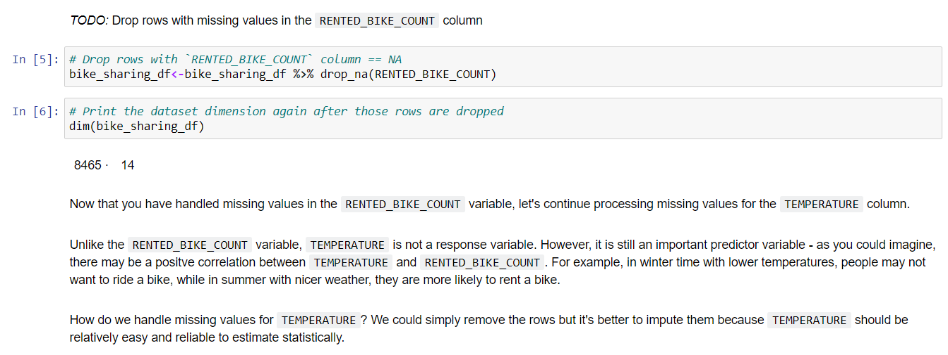
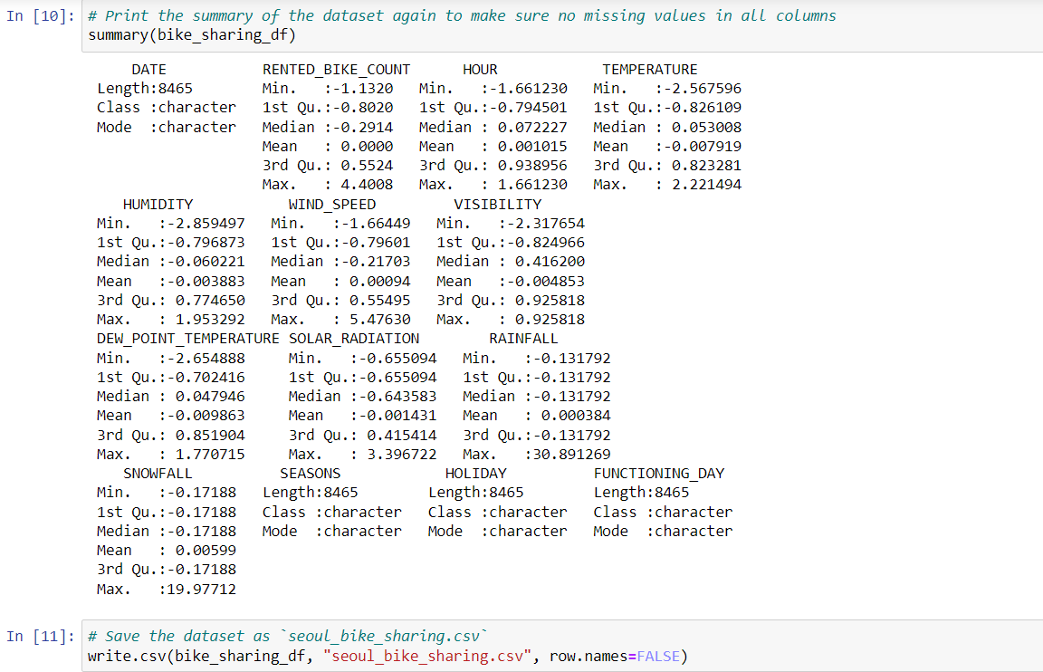
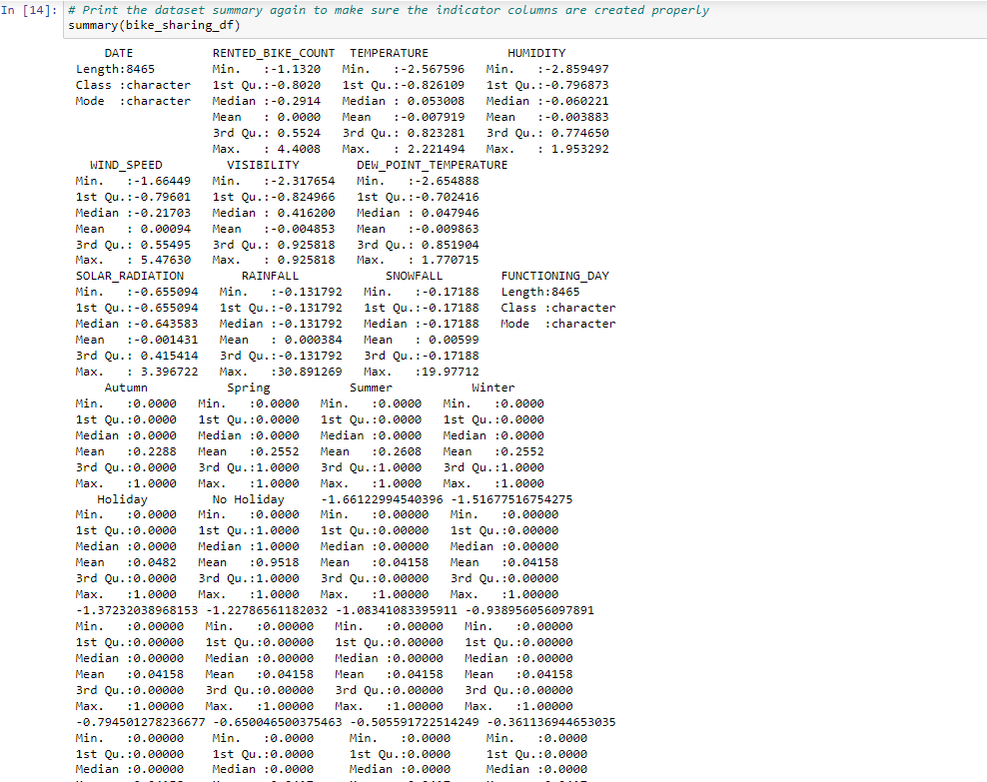
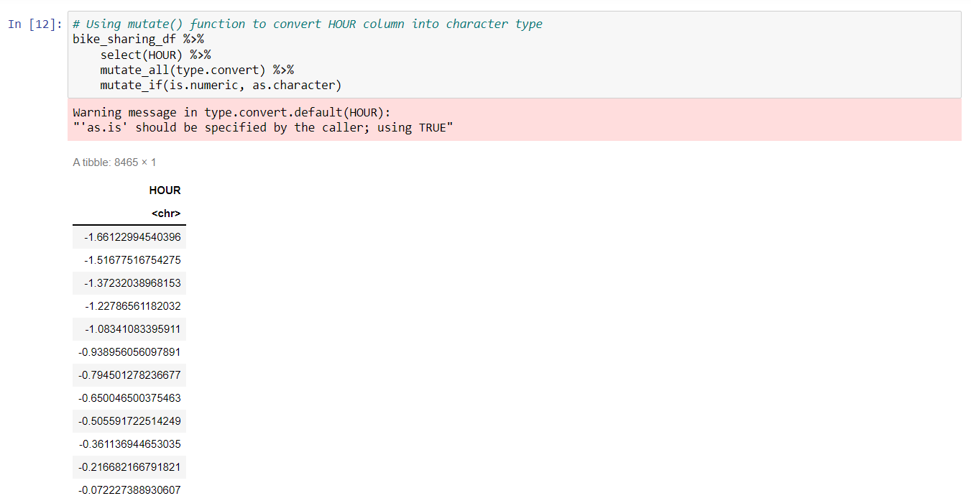
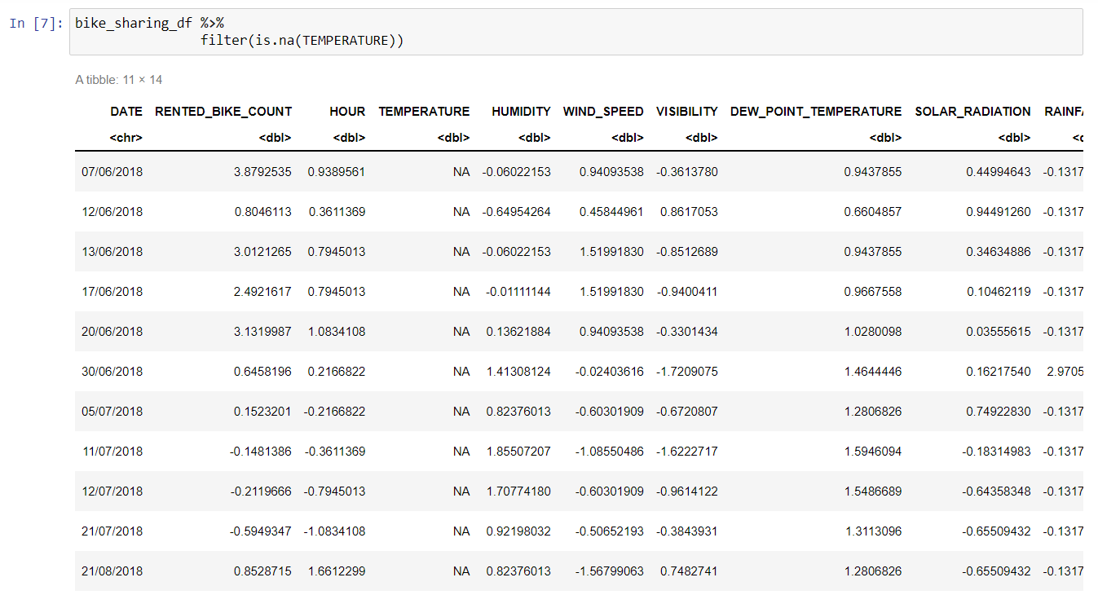
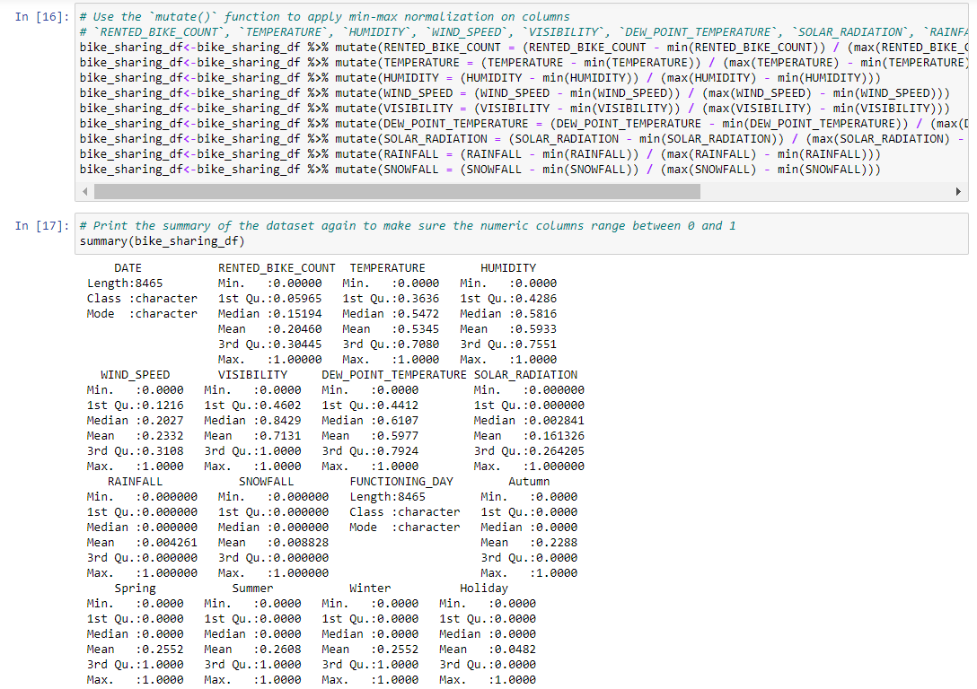
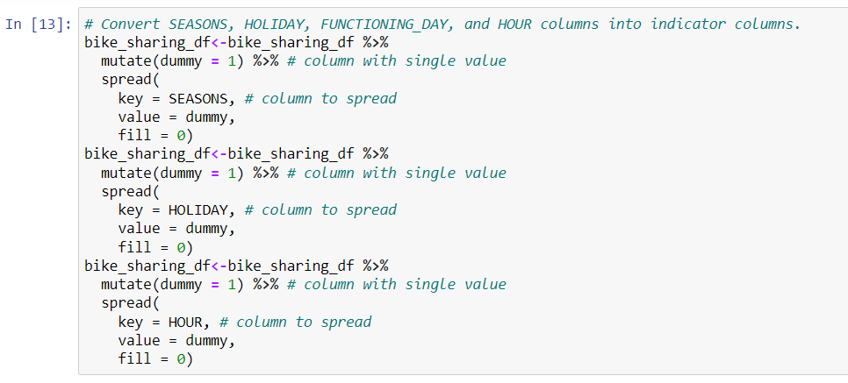
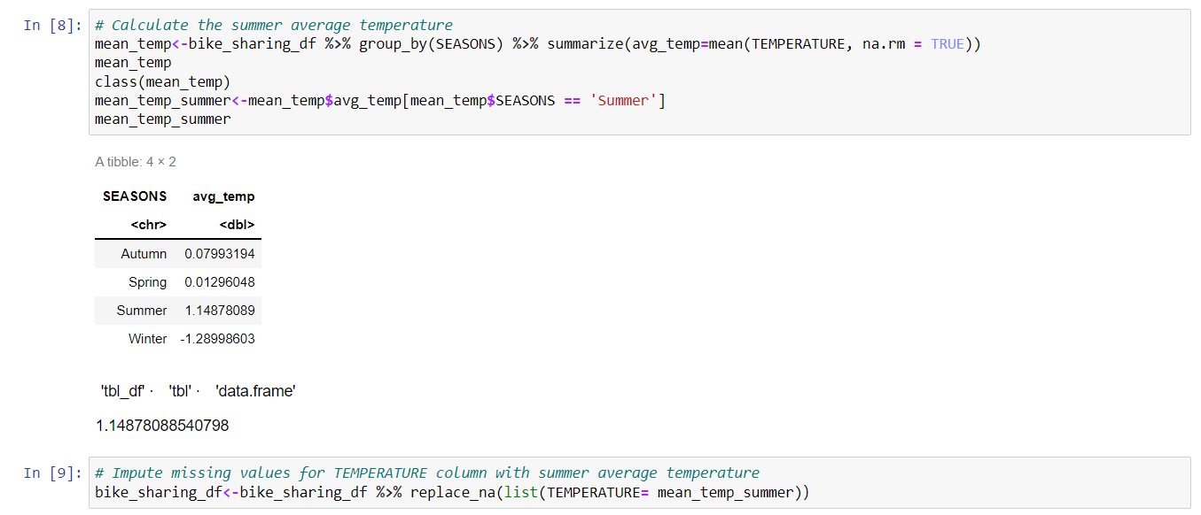
Data Wrangling

Slide 40
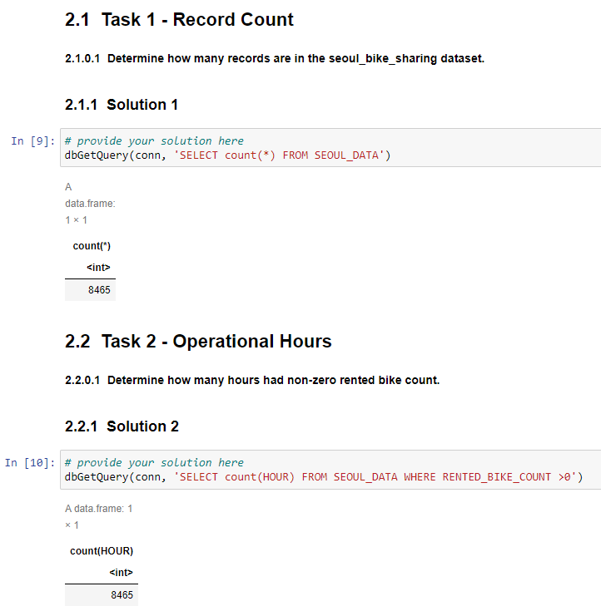
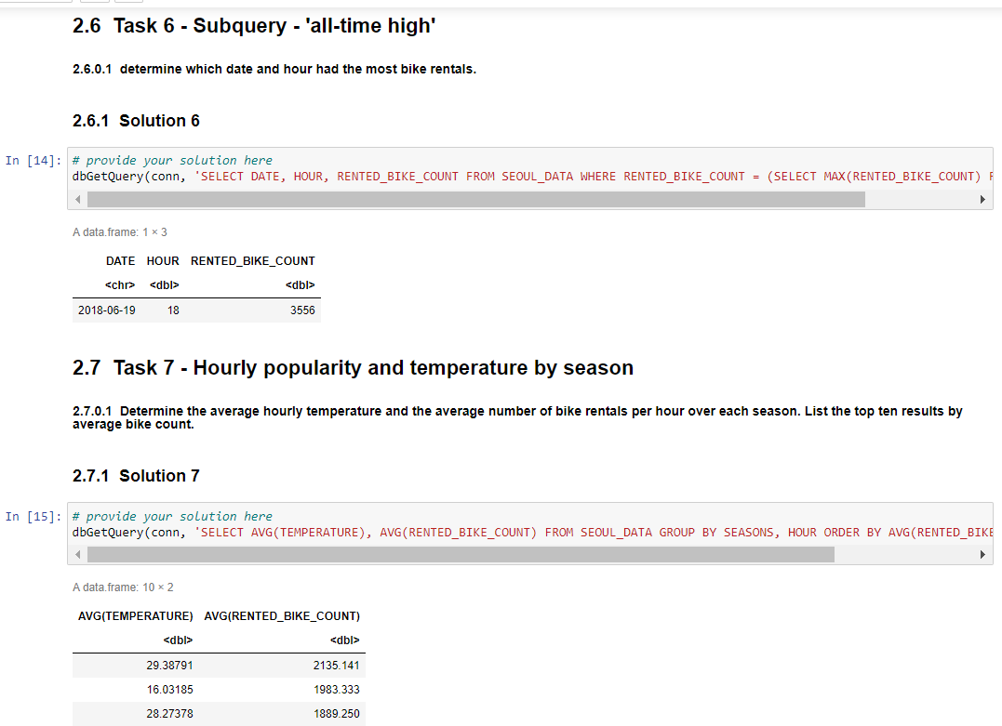
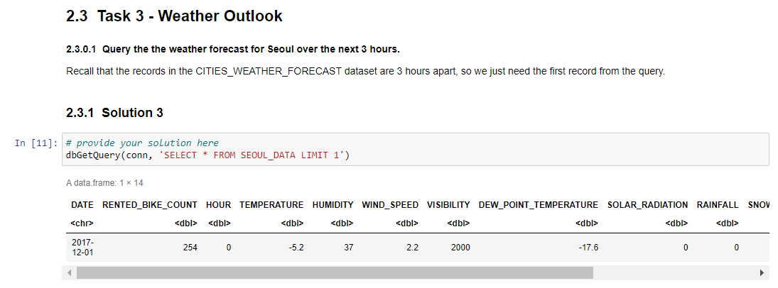
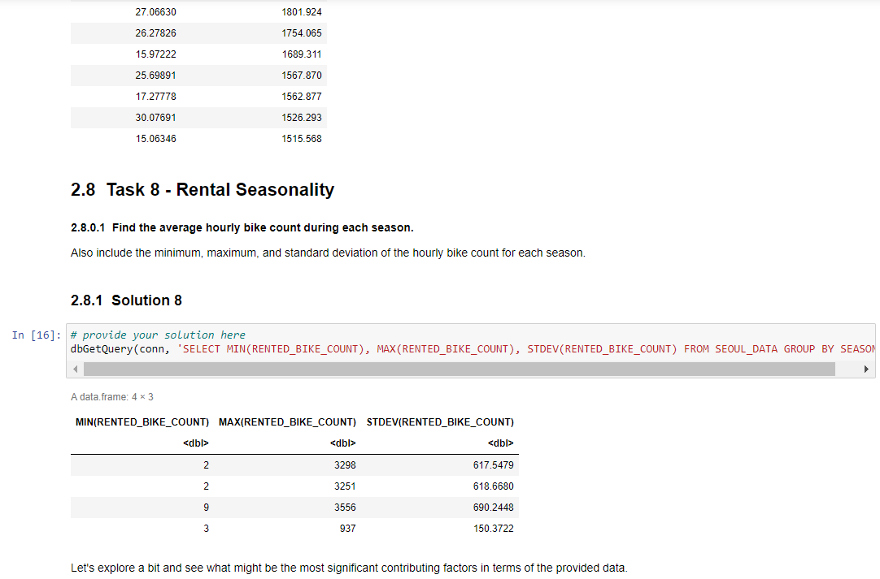
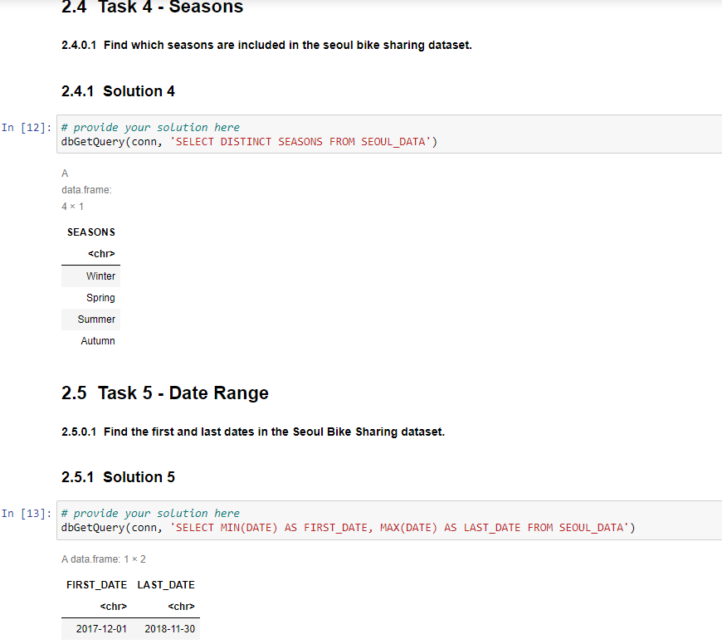
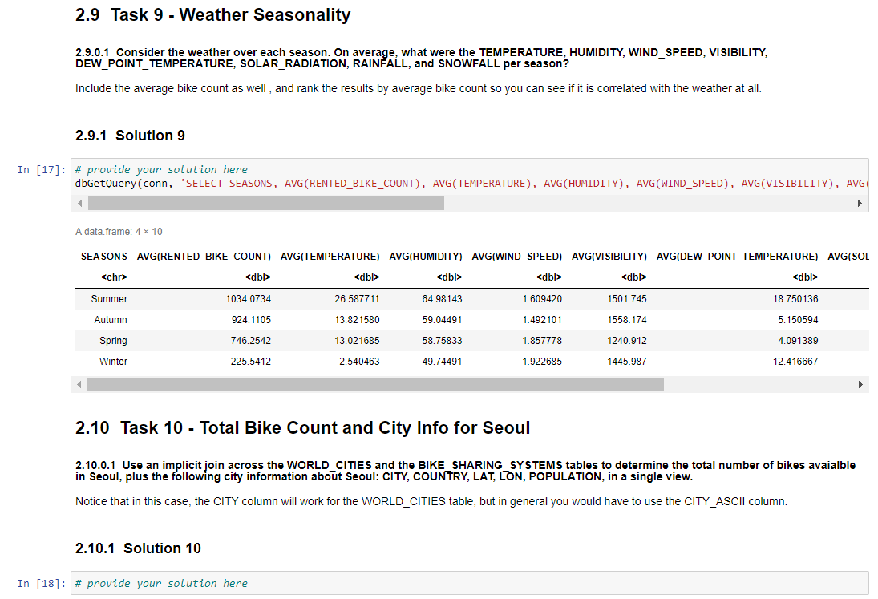
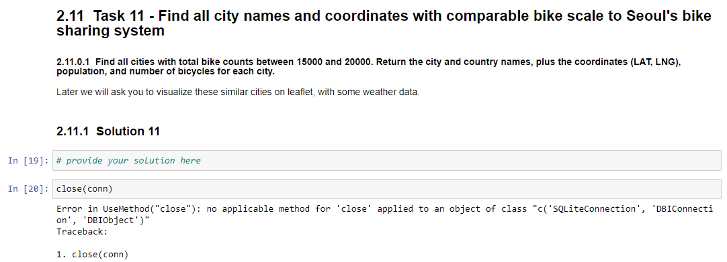
SQL Queries

Slide 41
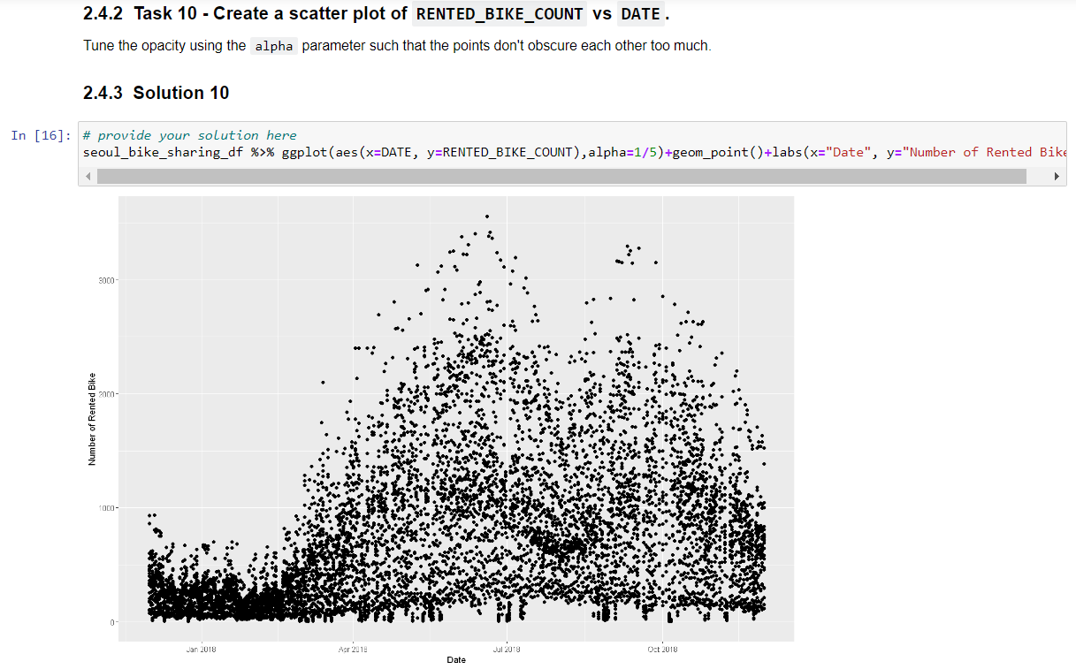
EDA Plots

Slide 42
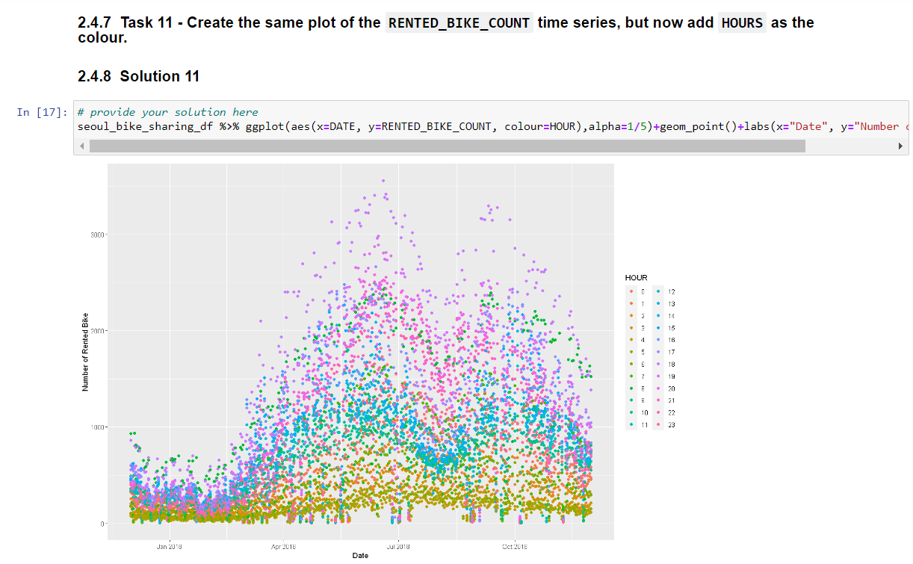
EDA Plots

Slide 43
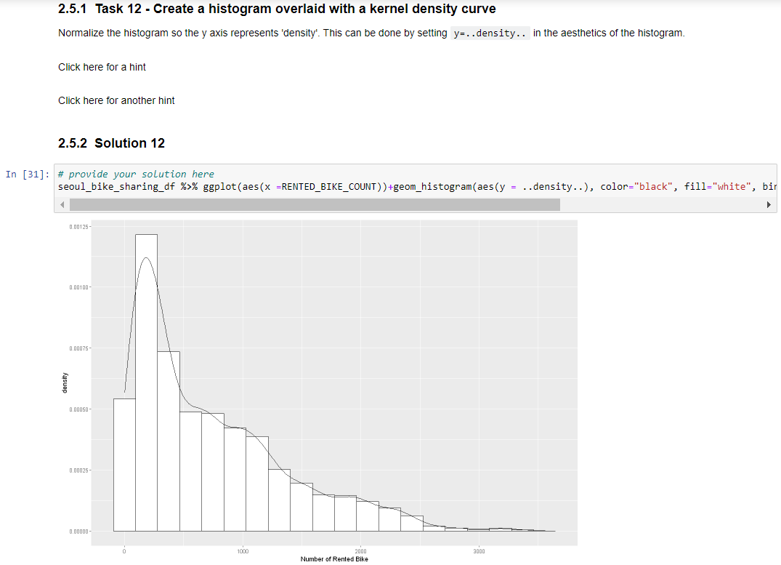
EDA Plots

Slide 44
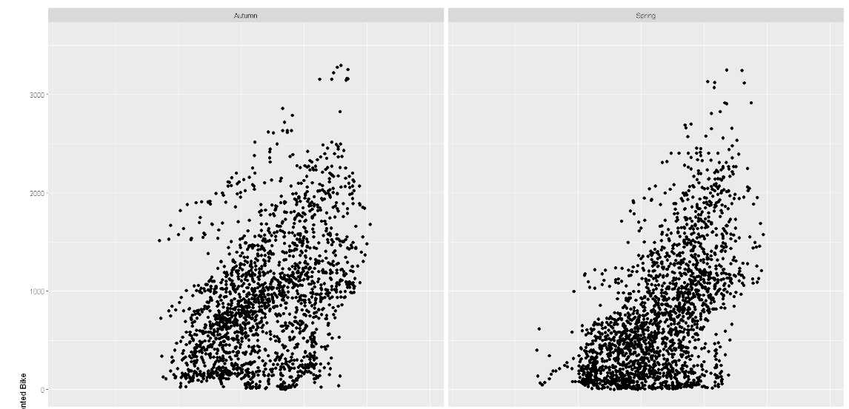
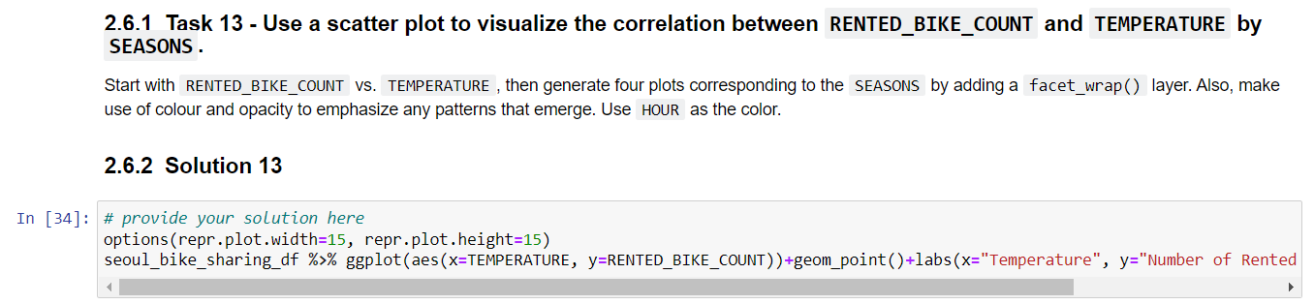
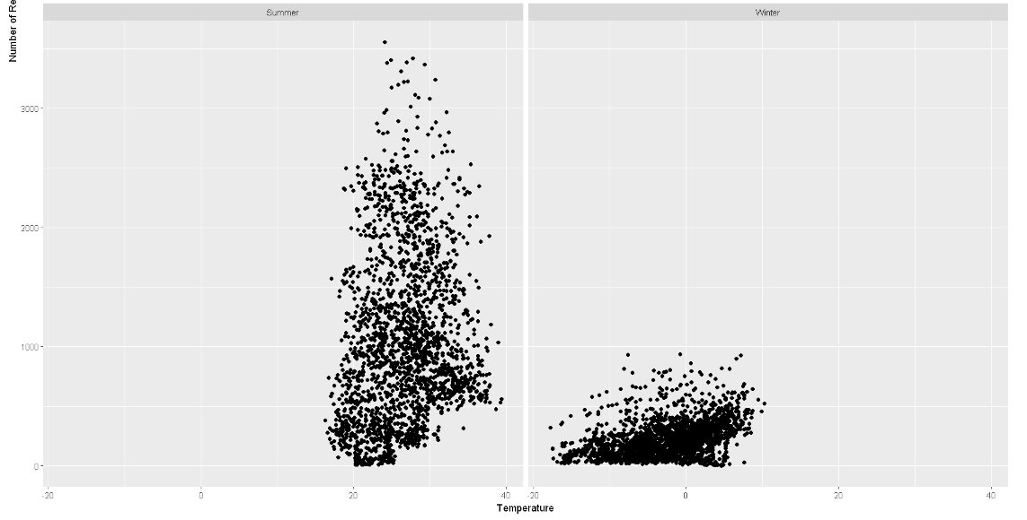
EDA Plots

Slide 45
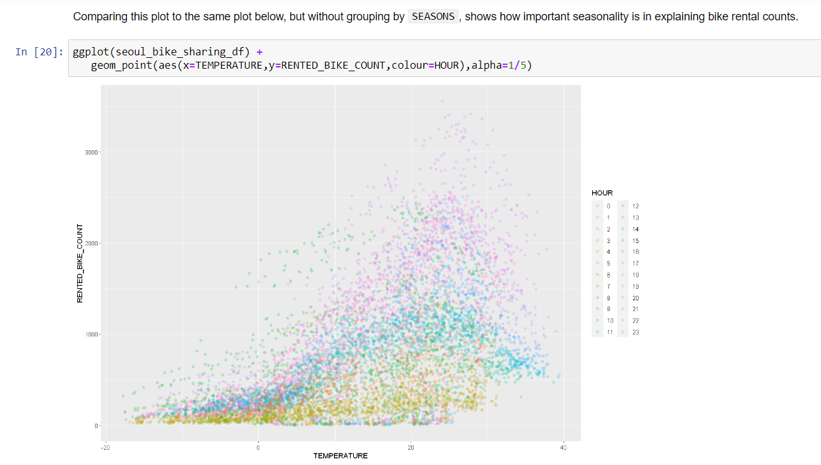
EDA Plots

Slide 46
EDA Plots

Slide 47
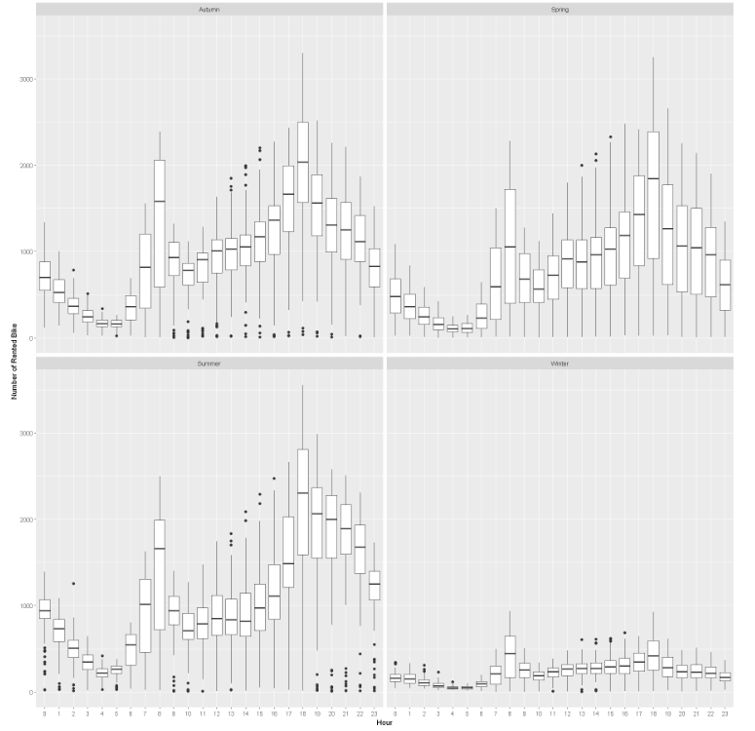
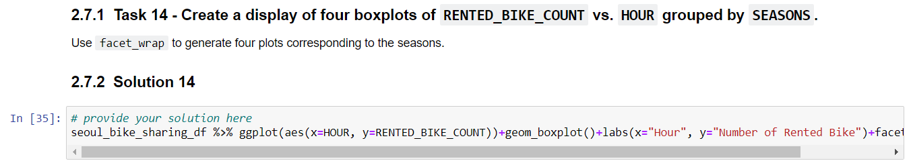
EDA Plots

Slide 48
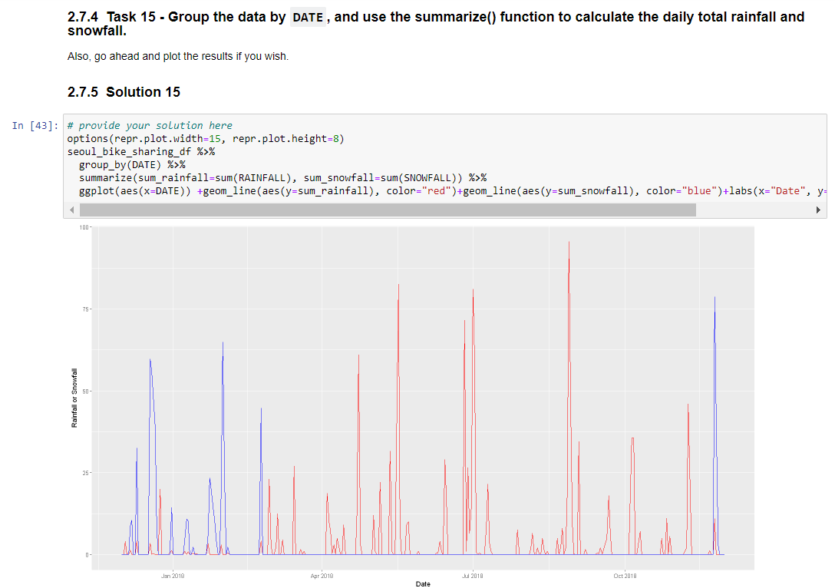
EDA Plots

